Slide 1
Data Communication and
Networks

Slide 2
Network Layer
Switching

Slide 3
Overview
Introduction
Duties of Network Layer
Network Layer Design Issues
Switching
Circuit switching
Message switching
Packet switching

Slide 4
Introduction
  Network layer in the Internet model is responsible for carrying packet from one computer to another.
  Figure shows the positions of the network layer in the 5-layer Internet model.
  Network layer is the 3rd layer in the model.
  It receives services from the DLL and provides services to the transport layer.

Slide 5
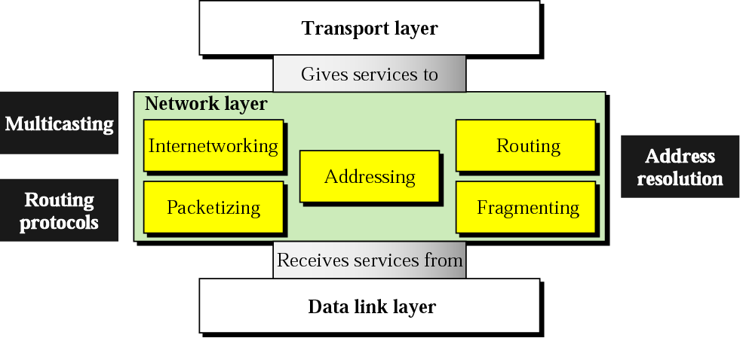
Position of network layer

Slide 6
Duties of Network layer
Duties of NL are Internetworking, Addressing, Routing, Packetizing and Fragmenting.
Internetworking
Main duty of the N/W is to provide internetworking, the logical grouping of heterogeneous physical networks together to look like a single network to the upper layers.

Slide 7
Addressing
Identify each device on the Internet to allow global communication between all devices.
Routing
Whenever there are multiple routes to a destination, we must take a decision and choose one route.

Slide 8
Packetizing
N/W encapsulates packets received from upper-layer protocols and makes new packets out of them.
In the Internet model, packetizing is done by a network layer protocol called IP.

Slide 9
Fragmenting
A datagram can travel through different networks.
Each router decapsulates the IP datagram from the received frame, processes it, and then encapsulates it in another frame.
The format and size of the received frame depend on the protocol used by the physical network from the frame has just arrived.

Slide 10
Network layer Design issues
Issues include service provided to the TL and the internal design of the subnet.
  Store-and-Forward Packet Switching
  Services Provided to the Transport Layer
  Implementation of Connectionless Service
  Implementation of Connection-Oriented Service

Slide 11
Store-and-Forward Packet Switching
But before starting to explain the details of the network layer, it is probably worth restating the context in which the network layer protocols operate.
The major components of the system are the carrier's equipment shown in figure.

Slide 12
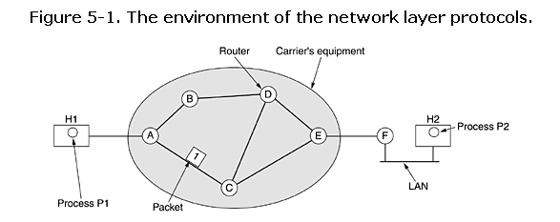
Routers connected by transmission lines are shown inside the shaded oval, and the customers' equipment, shown outside the oval.
Host H1 is directly connected to one of the carrier's routers, A, by a leased line.

Slide 13
In contrast, H2 is on a LAN with a router, F, owned and operated by the customer.
This router also has a leased line to the carrier's equipment.

Slide 14
F as being outside the oval because it does not belong to the carrier, but in terms of construction, software, and protocols, it is probably no different from the carrier's routers.
A host with a packet to send transmits it to the nearest router, either on its own LAN or over a point-to-point link to the carrier.

Slide 15
The packet is stored there until it has fully arrived so the checksum can be verified.
Then it is forwarded to the next router along the path until it reaches the destination host, where it is delivered.

Slide 16
Services Provided to the Transport Layer
What kind of services the network layer provides to the transport layer?
NL Services have been designed with the following goals in mind:
  Services should be independent of router technology.
  TL should be shielded from the number, type, and topology of the routers present.
  Network addresses made available to the TL should use a uniform numbering plan, even across LANs and WANs.

Slide 17
Given these goals, the designers of the NL have a lot of freedom in specification of the services to be offered to the TL.
That centers on whether the NL should provide connection-oriented or connectionless service.
Internet offers connectionless NL service.
An ATM network offers connection-oriented NL service.

Slide 18
Switching
To understand the concept of internetworking, the need for network layer in an internetwork and also need to understand the type of switching used.
To make one-to-one communication between multiple network devices is a major problem.
Because it requires number and length of the links require too much infrastructure and majority of the links would be idle most of the time.
Using bus topology also difficult for long distance between devices and large number of devices.
Better solution is switching.

Slide 19
A switched network consists of a series of interlinked nodes, called switches.
Switches are Hardware and Software devices capable of creating temporary connections between two or more devices linked to the switch.
A WAN has many interconnected switching nodes.
A transmission from a device is routed through these nodes to the specified destination device.

Slide 20
There are three connection strategies.
  Circuit switching
  Message switching
  Packet switching
WANs have been implemented using packet switching and circuit switching.

Slide 21
Circuit switching
Circuit switching creates direct physical connection between 2 devices such as telephones or computers.
A communications path is established between two stations through the nodes of the network.
Path is a connected sequence of physical links between nodes.
Once a connection is made between two nodes, it is maintained until one of them terminates.
Connection is dedicated between two.
Network maintains the connection until a node terminates it.

Slide 22
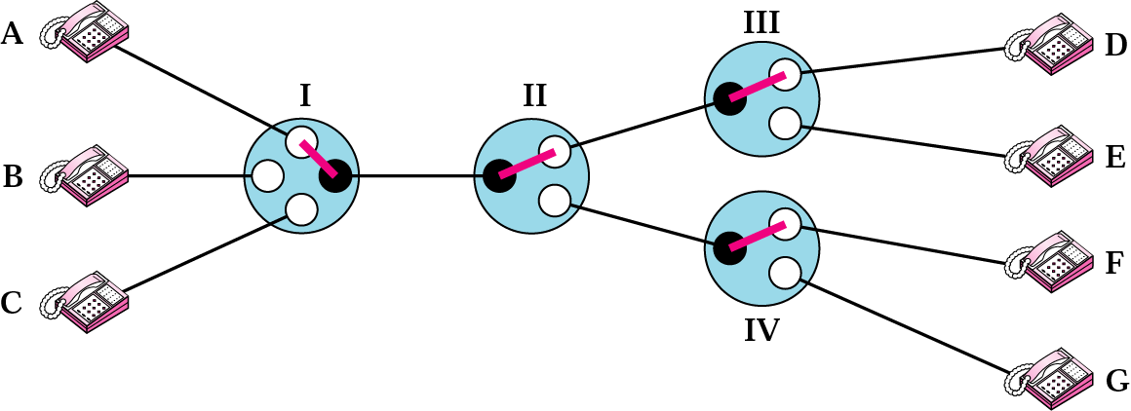
Circuit-switched network
On each link, a logical channel is dedicated to the connection
Instead of point-to-point connections between the 3 telephones on the left to the 4 devices on the right (requiring 12 links), we can reduce the number and total length of the links.

Slide 23
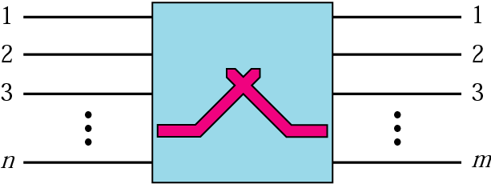
A circuit switch
It is a device with n inputs and m outputs that create a temporary connection between an input link and an output link.
No. of inputs does not have to match the number of outputs.
Circuit switching uses 2 technologies: Space-divison switch or time-division switch.

Slide 24
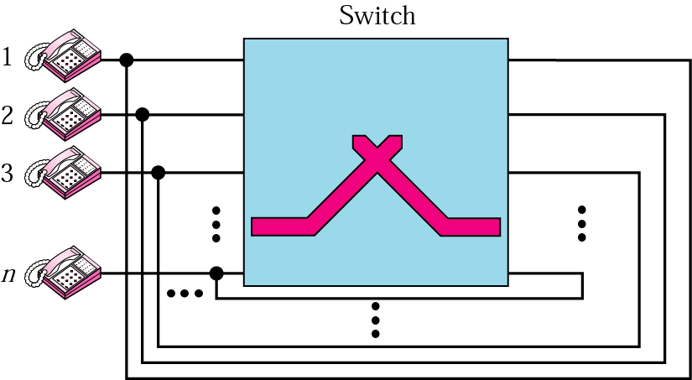
A folded switch

Slide 25
Space-Division Switch
Path in the circuits are separated from each other spatially.
Originally designed for analog networks, but currently used in both analog and digital networks.

Slide 26
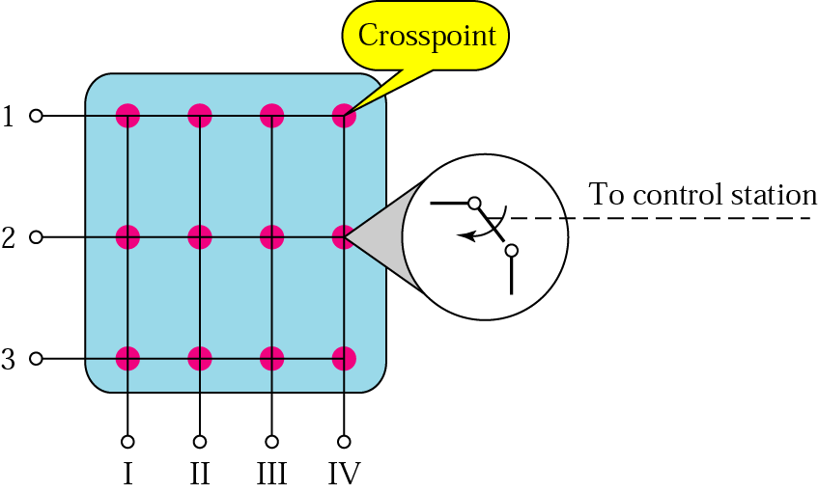
Crossbar switch
It connects n inputs to m outputs in a grid, using electronic micro switches (transistors) at each cross point.
Major limitation of this design is the no. of cross points required.
For example, 1000 inputs to 1000 outputs requires a 1000,000 cross points.
It is impractical. It is also inefficient because 25% of the cross points are in use at any given time.

Slide 27
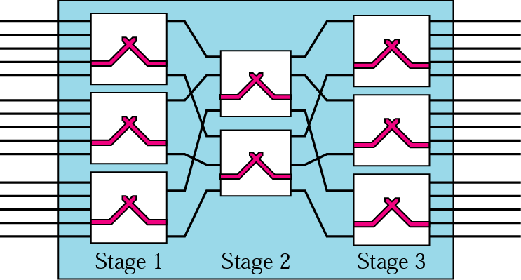
Multistage switch
Solution to the limitation of the crossbar switch is the multistage switch.
Design of a multistage switch depends on the no. of stages and the no. of switches required in each stage.
Normally middle stages have fewer switches than first and last stages.

Slide 28
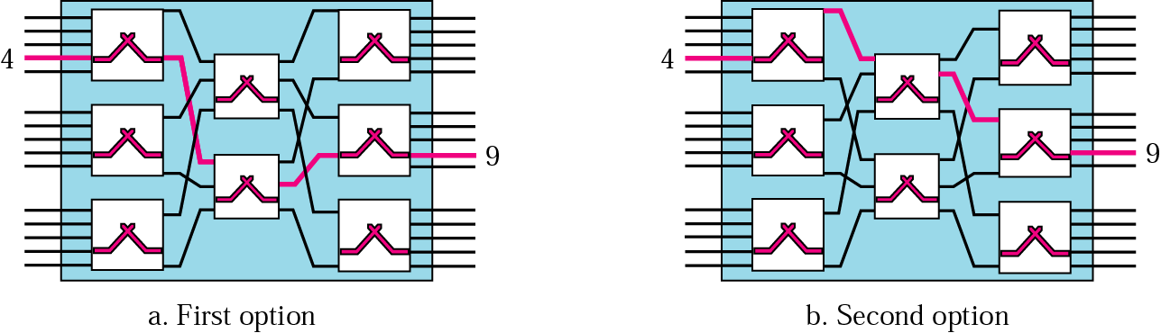
Switching path

Slide 29
Time-Division Switch
Uses TDM to achieve switching.
2 popular methods used in TDM: TSI and the TDM bus.

Slide 30
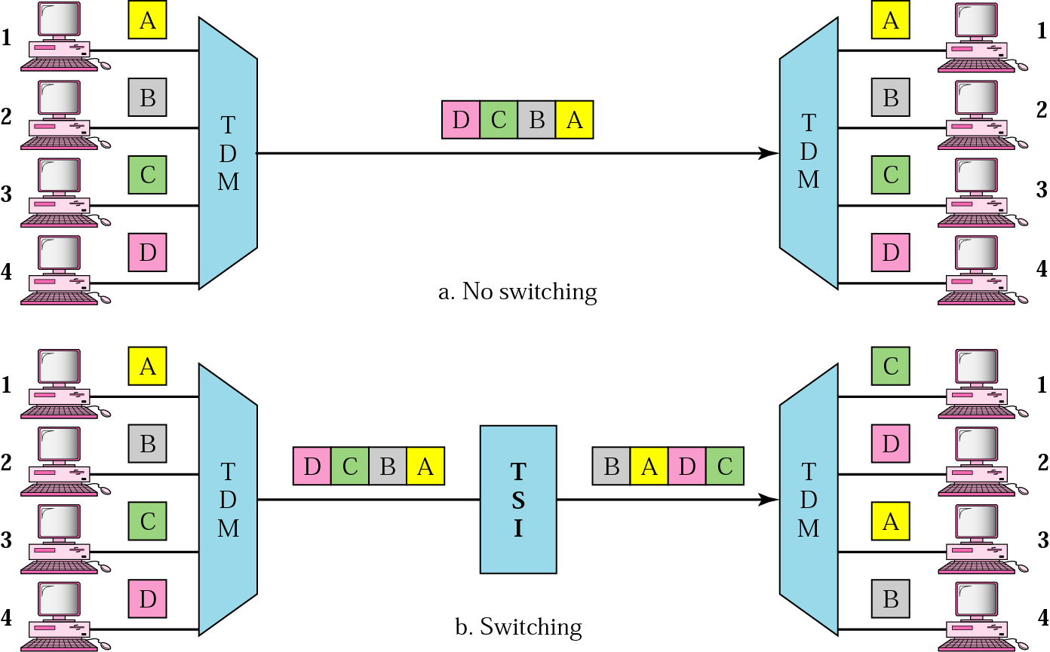
Time-division multiplexing, without and with a time-slot interchange

Slide 31
Time-Slot Interchange
Insert a device called TSI into the link.
TSI changes the ordering of the slots based on the desired connections.
In this case, it changes the order of data from A, B, C, D to C, D, A, B.

Slide 32
How TSI works?
TSI consists of RAM with several memory locations.
Size of each location is same as the size of a single time slot.
Number of locations is same as the number of inputs (in most cases, no. of I/Ps and no. of O/Ps are equal).
RAM fills up with incoming data from time slots in the order received.
Slots are then sent out in an based on the decisions of a control unit.

Slide 33
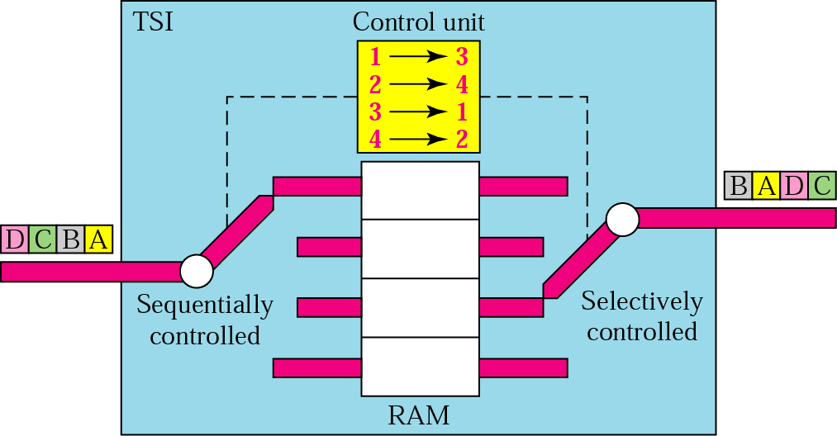
Time-slot interchange

Slide 34
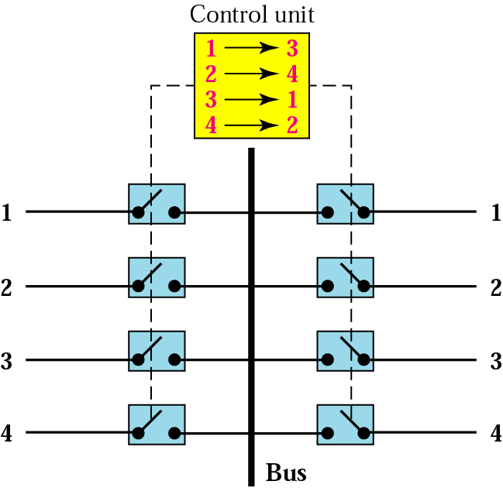
TDM bus
I/P and O/P lines are connected to a high-speed bus through input and output gates.
Each input gate is closed during one of the 4 time slots.
During the same time slot, only one output is also closed.

Slide 35
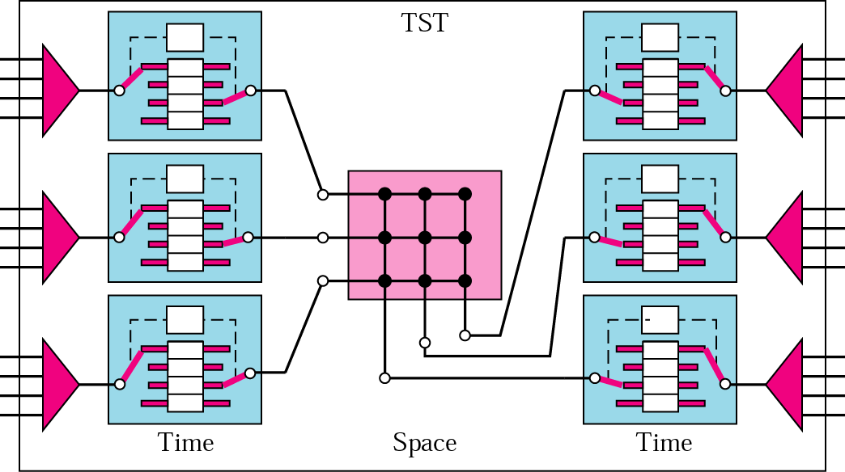
TST switch

Slide 36
Message switching
Alternative to circuit switching.
A network uses message switching to establish a route when a message is sent.
Here message is stored in its entirety at each node, network that use this method called store-and-forward networks.

Slide 37
How are message switching and circuit switching different?
In message switch, message is stored temporarily at each node.
Transmission delays resulting the message switching unsuitable for telephone networks.
In circuit, single route is dedicated to the exchange of all messages between nodes.
In message, different message can travel over different routes.
In circuit, both parties are ready when data is sent. But message does not.

Slide 38
Packet switching
Internet as a packet-switched Network.
Minimizes the effects of problem caused by long messages on message-switched networks.
Long messages may exceed the buffering capacity.
Failure in a connection loss of the entire message.
In this, data are sent out in forms of small packets.
Size is design dependent.

Slide 39
Each packet contains its destination address.
Each packet is passed through the network from node to node along some path leading from source to destination.
At each node, the entire packet is received, stored briefly and transmitted to the next node.
Physical connection between the two end points is not maintained.
Two common routing methods in packet-switched networks are the Datagram and virtual circuit.

Slide 40
Datagram Approach
Each packet is transmitted independently.
Even if one packet is just a piece of a multipacket transmission, the network treats as it is.
Here, the packet arrive the destination out of order.
In most protocols, it is the responsibility of an upper layer to reorder.

Slide 41
It has some advantages:
    It does not need call setup and VC identifiers.
    Routing and delivery of the packet are based on the source and destination addresses.
    Switches or routers each have a routing table that can decide.
Switching at the NL in the Internet is done using the datagram approach to packet switching.

Slide 42
Disadvantages of Datagram
When message consists of many packets, independent routing represents a lot of overhead.
Packets may not arrive in the order in which they were sent.

Slide 43
Implementation of Connectionless Service
Two different organizations are possible, depending on the type of service offered.
If connectionless service is offered, packets are injected into the subnet individually and routed independently of each other.
No advance setup is needed.
In this context, the packets are frequently called datagrams (in analogy with telegrams) and the subnet is called a datagram subnet.

Slide 44
Routing of datagrams
Here each packet switching node maintains a forwarding table that indicates the port through which an end system can be reached.
When a data packet, carrying the destination address, is received by a packet switching node, it consults the forwarding table.
Forwarding table is used to determine the outgoing port towards destination address and puts the packets in the queue at that port.
All the datagrams are individually route across the network by the nodes to their destinations.
The nodes are called as ROUTERS

Slide 45
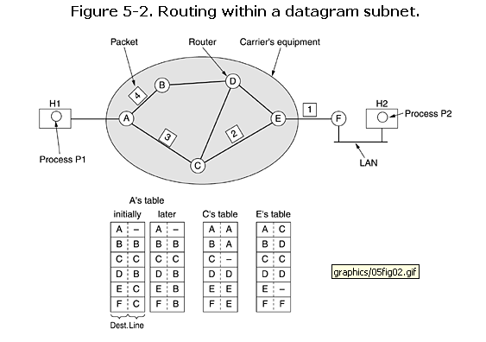
How a datagram subnet works?

Slide 46
Suppose that the process P1 in Figure has a long message for P2.
It hands the message to the transport layer with instructions to deliver it to process P2 on host H2.
The transport layer code runs on H1, typically within the operating system.

Slide 47
It pretends a transport header to the front of the message and hands the result to the network layer, probably just another procedure within the operating system.

Slide 48
Let us assume that the message is four times longer than the maximum packet size.
so the network layer has to break it into four packets, 1, 2, 3, and 4 and sends each of them in turn to router A using some point-to-point protocol, for example, PPP.
At this point the carrier takes over.

Slide 49
Every router has an internal table telling it where to send packets for each possible destination.
Each table entry is a pair consisting of a destination and the outgoing line to use for that destination. Only directly-connected lines can be used.

Slide 50
A has only two outgoing lines—to B and C—so every incoming packet must be sent to one of these routers, even if the ultimate destination is some other router.
A's initial routing table is shown in the figure under the label ''initially.''

Slide 51
As they arrived at A, packets 1, 2, and 3 were stored briefly (to verify their checksums).
Then each was forwarded to C according to A's table. Packet 1 was then forwarded to E and then to F.
When it got to F, it was encapsulated in a data link layer frame and sent to H2 over the LAN. Packets 2 and 3 follow the same route.

Slide 52
something different happened to packet 4.
When it got to A it was sent to router B, even though it is also destined for F.
For some reason, A decided to send packet 4 via a different route than that of the first three.

Slide 53
The algorithm that manages the tables and makes the routing decisions is called the routing algorithm.

Slide 54
Creating and maintaining forwarding tables is a very important task in datagram switching
Forwarding table must be consistent
Forwarding must reflect the current topology of the subnetwork.
There should not be endless routing loops.
If a link or node is down, alternate routes need to be defined immediately.

Slide 55
Definitions of Routing
Routing is commonly interpreted as the process of deciding and forwarding a packet along a route.
In data networks, routing refers to the process of creation and maintenance of the forwarding tables.
The act of switching packets from one port to another is simply switching of forwarding but not routing.
Routing protocols is the protocol for learning network topology and updating network topology changes in the forwarding tables.

Slide 56
Virtual Circuit Approach
In virtual circuit, network protocols establish a route before sending any packets.
Delivery of packets using the same route ensures that the packet arrive in order and without error.
Process is similar to circuit, but the route is not dedicated. Different VC may share a common network connection.
This approach is used in WAN, Frame Relay and ATM and is implemented at the Data Link Layer.

Slide 57
Implementation of Connection-Oriented Service
For connection-oriented service, we need a virtual-circuit subnet. Let us see how that works.
The idea behind virtual circuits is to avoid having to choose a new route for every packet sent.
With connection-oriented service, each packet carries an identifier telling which virtual circuit it belongs to.

Slide 58
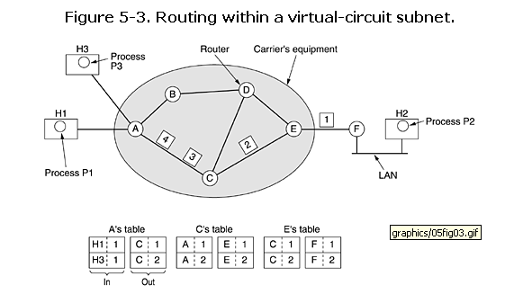
Here, host H1 has established connection 1 with host H2.
It is remembered as the first entry in each of the routing tables.
The first line of A's table says that if a packet bearing connection identifier 1 comes in from H1, it is to be sent to router C and given connection identifier 1.

Slide 59
Similarly, the first entry at C routes the packet to E, also with connection identifier 1.
Now let us consider what happens if H3 also wants to establish a connection to H2.

Slide 60
It chooses connection identifier 1 (because it is initiating the connection and this is its only connection) and tells the subnet to establish the virtual circuit.
This leads to the second row in the tables.

Slide 61
Note that we have a conflict here because although A can easily distinguish connection 1 packets from H1 from connection 1 packets from H3, C cannot do this. For this reason, A assigns a different connection identifier to the outgoing traffic for the second connection.

Slide 62
How are Packet switching and circuit switching different?
Packet-switching networks place a tight upper limit on block size, allowing packets to be buffered in router main memory instead of disk.
Packet switching does not require any advance setup.
Packet switching, depending on network conditions, packet may arrive out of order.
More fault tolerant than circuit switching.
In packet, no Bandwidth is reserved.
Packet switching uses store-and-forward transmission.
Circuit switching is completely transparent.

Slide 63
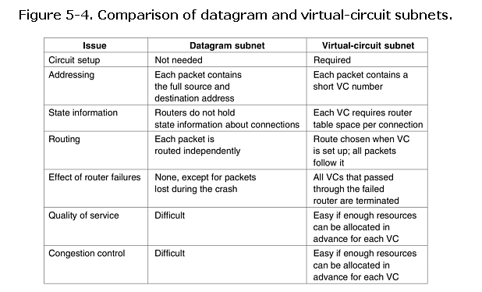

Slide 64
Advantages: Switching methods
Circuit switching:
  Speed.
  No danger of congestion.
Message switching:
  Routes are not dedicated and may reused immediately after the transmission.
  Receiver need not accept immediately.
Packet-switching:
  Network routes are utilized better.

Slide 65
Disadvantages: Switching methods
Circuit switching:
  Network connections are dedicated.
Message switching:
  Messages generally take longer to reach their destination.
  Problem may occur with long messages when messages are stored at intermediate

Slide 66
Packet-switching:
  More overheads.
  Routing decisions must be made for each packet.

